Slide 1
U.S. Army PEO STRI
Logistics Management System
Ben Benyehuda, Braden Cariaga, Henry Thiel, Timothy Glisson

Slide 2
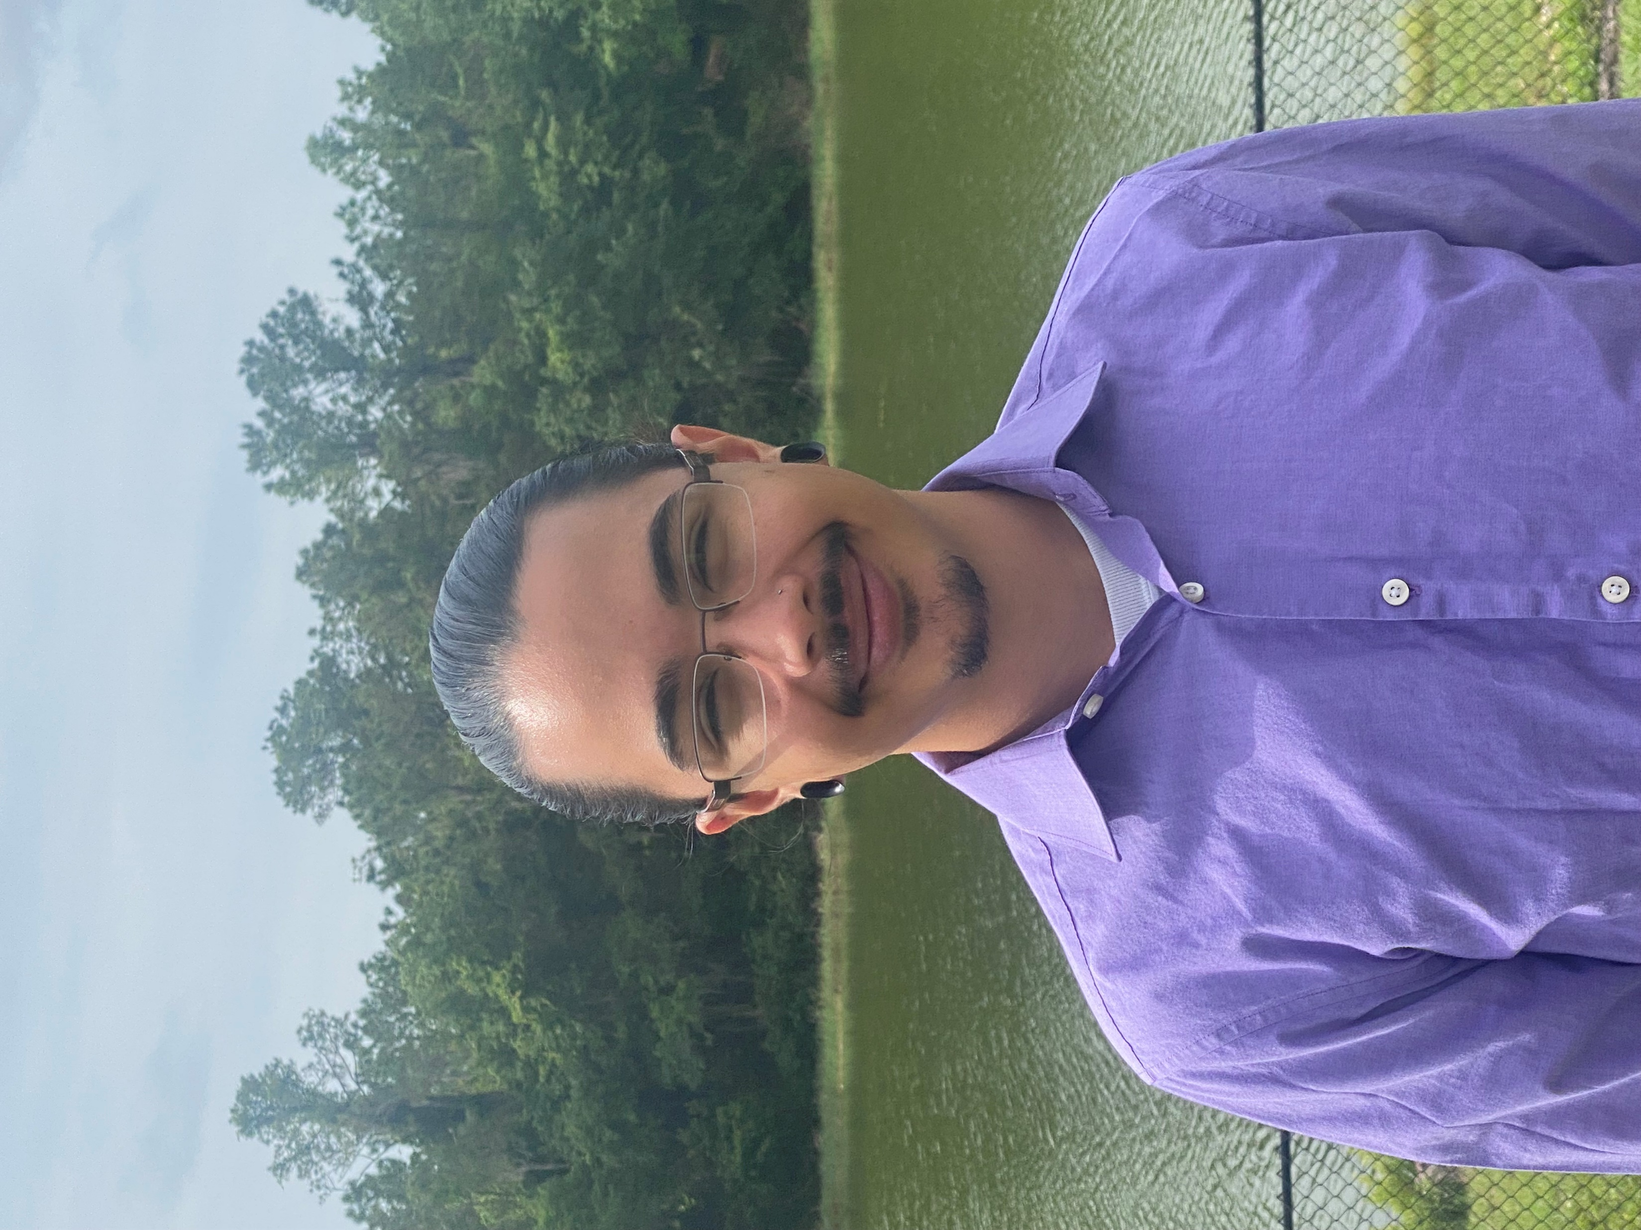


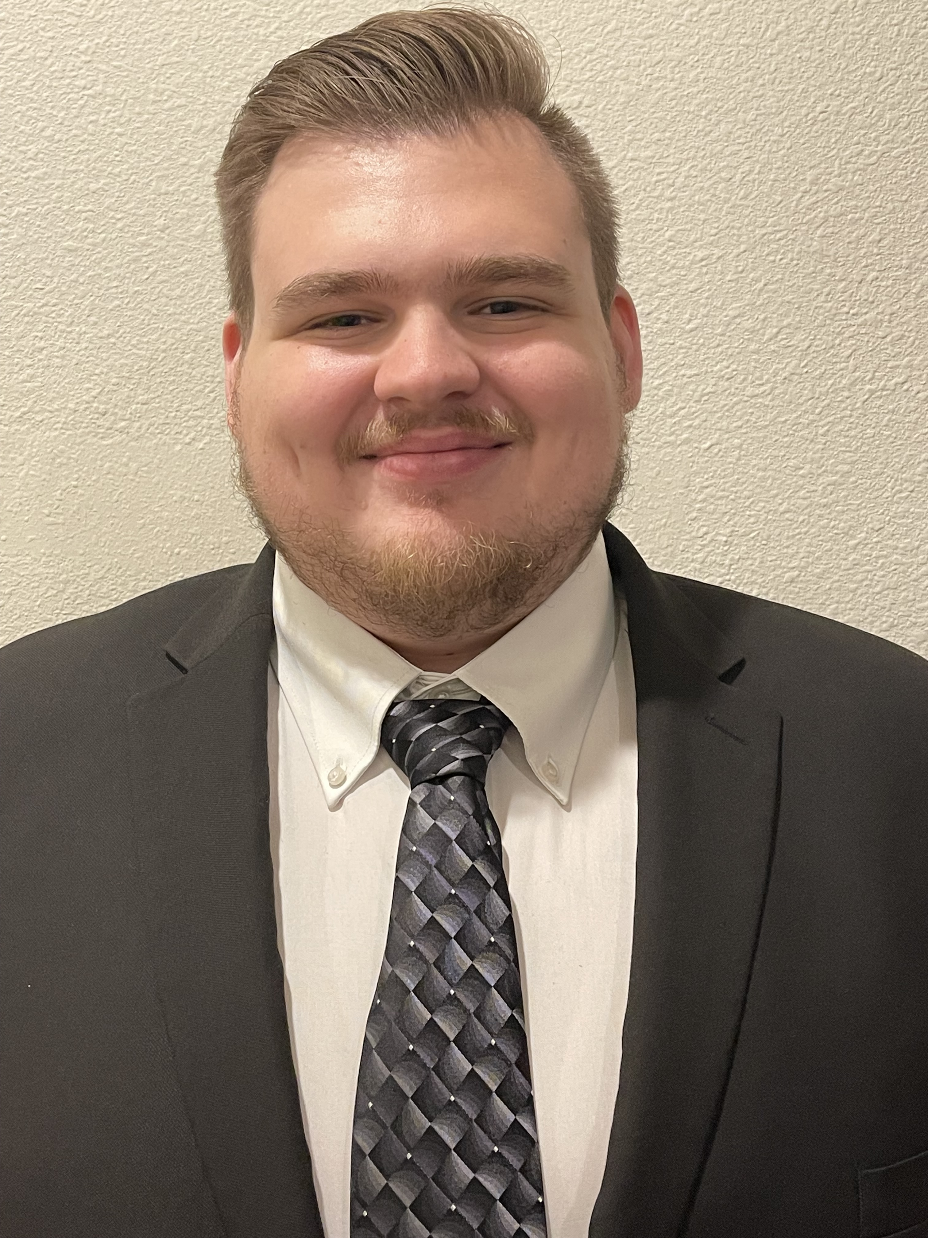
Our Team
Braden Cariaga
Henry Thiel
Ben Benyehuda
Timothy Glisson
Frontend Developer
Backend Developer
Project Coordinator
Business Analyst

Slide 3
PEO STRI
Program Executive Office Simulation, Training, and Instrumentation
Logistics Management Software
PEO STRI manages training and simulation for the US Army want an enterprise application to improve process and project workflow that:
Enable logisticians to populate status of requirements and sub-requirements
Route projects automatically to relevant users
Expose project status to outside parties
Implement “back-tracking” procedures
Simply processes
Notes:
Project Sponsor

Slide 4
PEO STRI Contacts
Rob Briar
Destiny Laski
Jeremy Lanman
Project Manager
Director of Logistics
Chief Technology Advisor

Slide 5
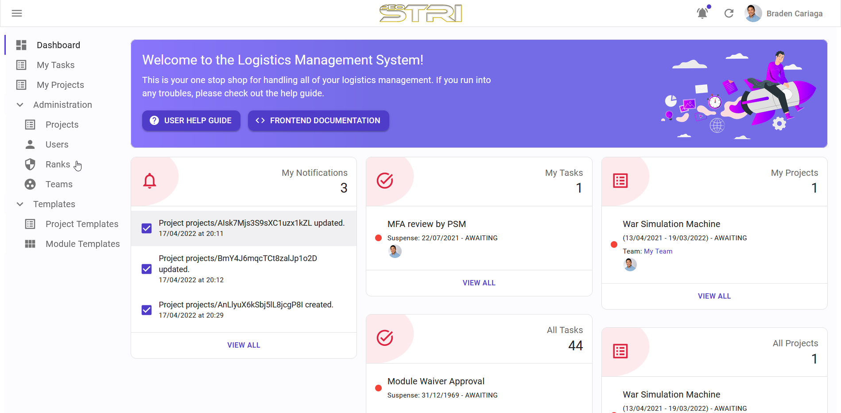
Desired Deliverables
Web Application
A self-hosted web application that enables logisticians and management to route requirements and sub-requirements to review/approval while providing process logistics.
Improved Process Workflow
An improved process workflow which enables synchronicity between different requirements and sub-requirements.

Slide 6
Major Tasks
CS – Produce a web application to manage and progress projects
File management
Automatic project notifications
Project dashboard and data views
DSBA – Improving the current process of task to be
Faster
More Efficient
Easier to track ongoing processes

Slide 7
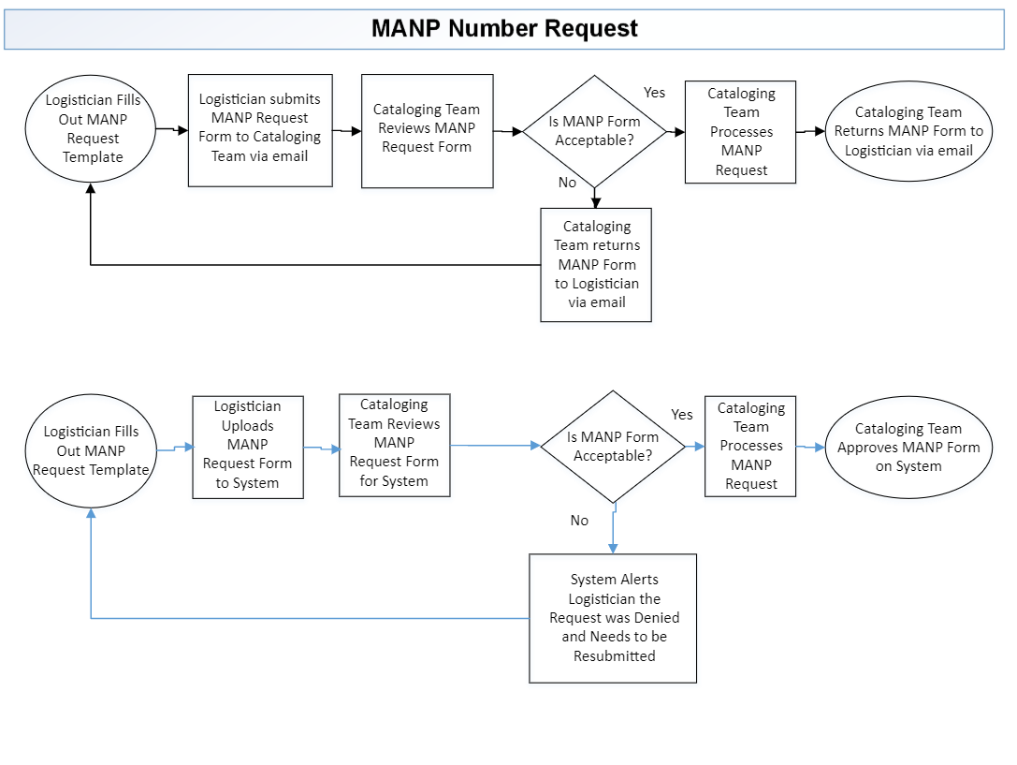

Slide 8
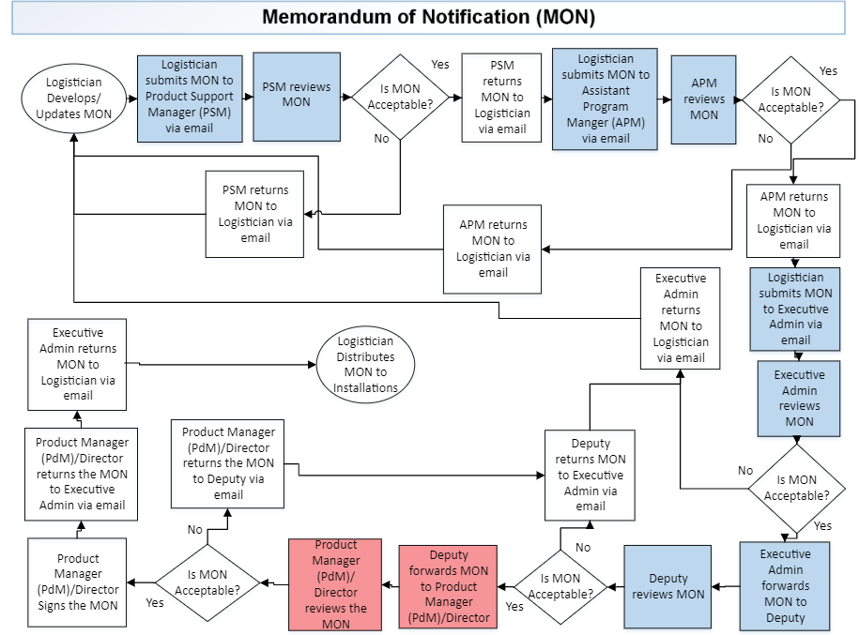

Slide 9
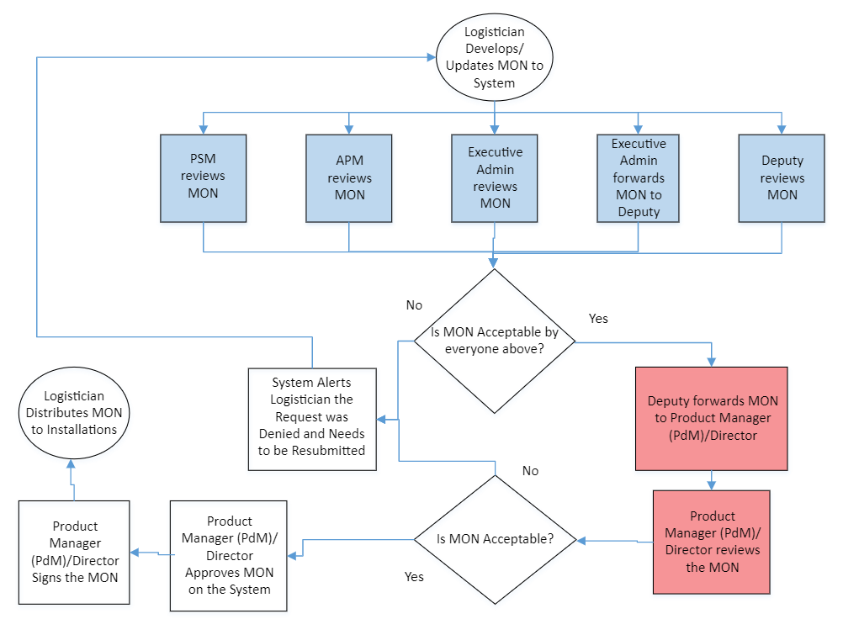

Slide 10
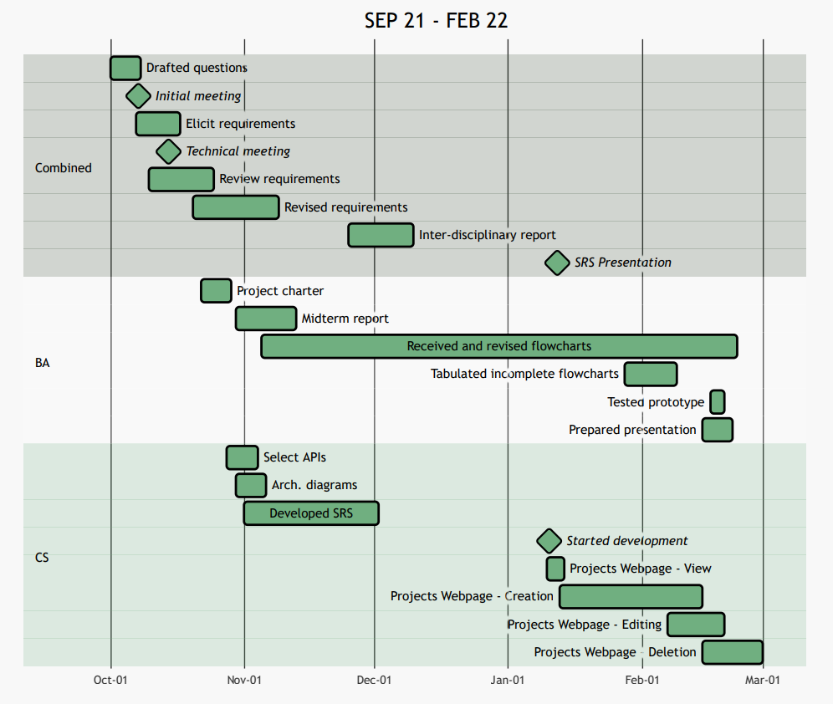
Gantt Chart
SEP 21 –
FEB 22

Slide 11
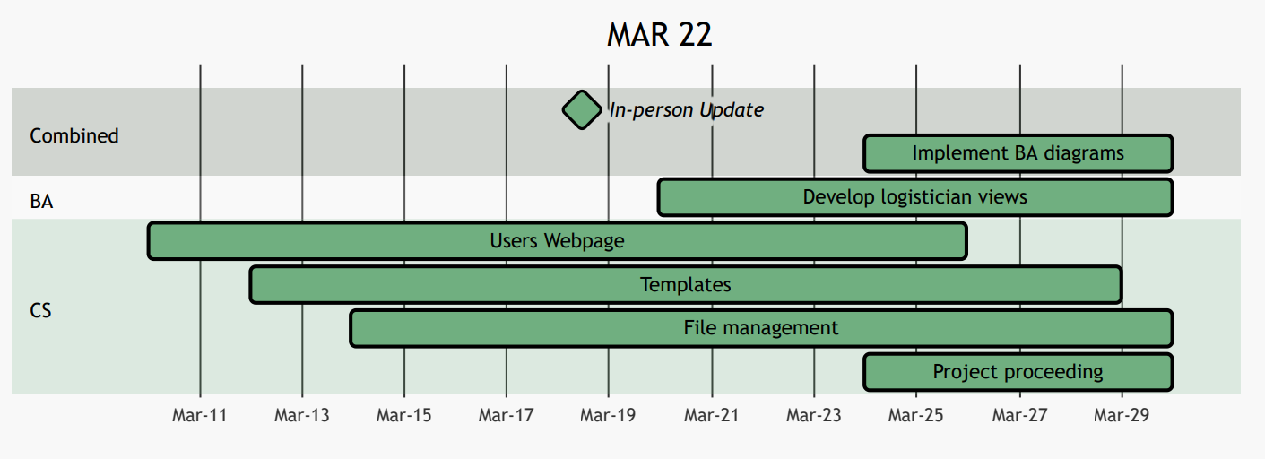
Gantt Chart
MAR 22

Slide 12
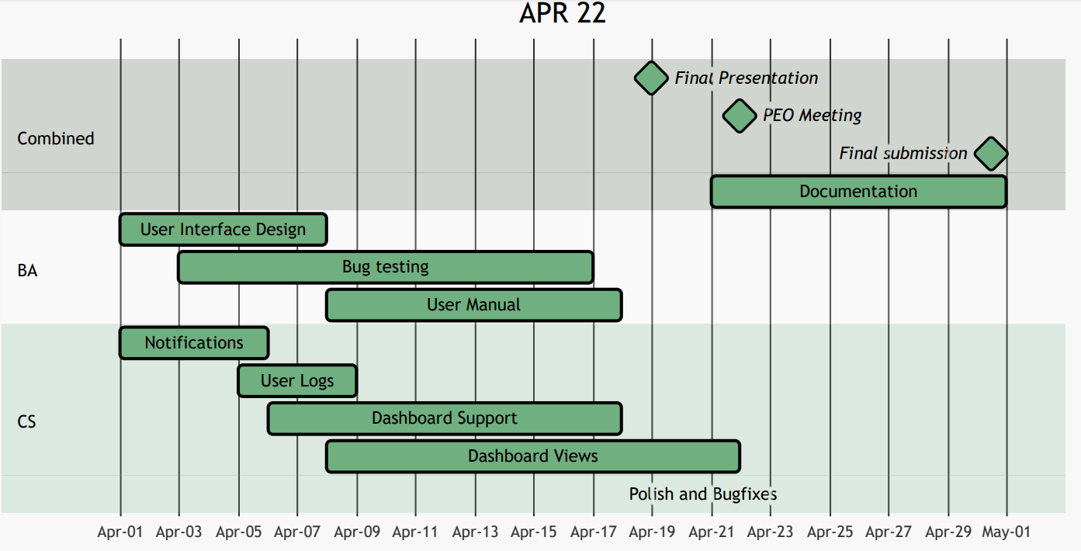
Gantt Chart
APR 22

Slide 13
Overview of Milestones
Testing
Utilized automated testing and manual user testing to determine the reliability and usability.
Development
Developed main application features in an agile workflow.
Design & Proposal
Analyzed the requirements to design a proposed solution to fit the customers needs.
Requirements
Collected and analyzed the sponsors needs.

Slide 14
Individual Contributions - Braden
Role: Frontend Developer
Overall Contributions
Braden
Design
30%
Development
45%
Contributions
Deliverables
25%
Design
Development
Documentation
Designed data structures and the frontend user interface
Designed and Developed the user interface
(Frontend)
Documented the frontend application programming interface

Slide 15
Individual Contributions - Henry
Role: Backend Developer
Overall Contributions
Henry
Design
30%
Development
45%
Contributions
Deliverables
25%
Design
Development
Documentation
Collaborated on internal data structures
Designed and Developed data population for the website (Backend)
Documented API requests and responses

Slide 16

Individual Contributions - Ben
Role: Project Coordinator, Business Analyst
Overall Contributions
Ben
Design
20%
Development
5%
Contributions
Deliverables
25%
Project Manager/Coordinator
Process Improvement
Assist in System Design
Point of contact between team and sponsor. Coordinating teamwork
Improved current workflow processes to be more efficient with new system
Identifying bugs
Template creation
System User Guide

Slide 17
Individual Contributions - Timothy
Role: Business Analyst
Overall Contributions
Timothy
Design
20%
Development
5%
Contributions
Deliverables
25%
Process Improvement
Documentation
UI Components
Worked on creating graphs for dashboard
Improved current workflow processes to be more efficient with new system
Create videos for user help guide and helped with bug testing

Slide 18
Final State of Project
Present
User Authentication & Administration
User Permissions
Project Proceeding
Logistical Data Population
Project Administration
Template Administration

Slide 19
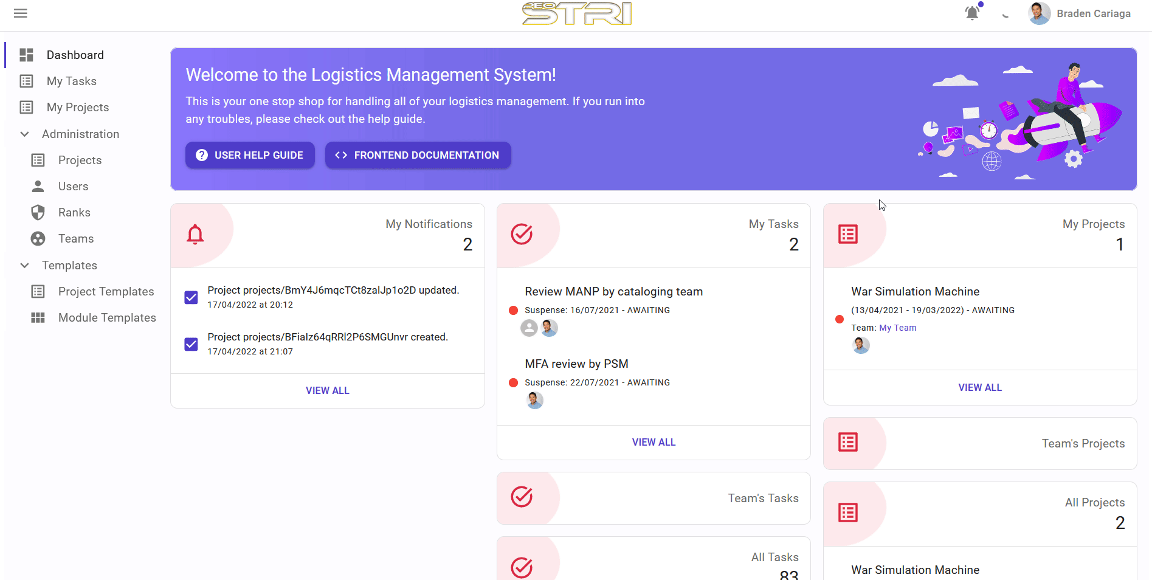

Slide 20
Testing Results
1
User Guides and Manual
Passed
2
User Study on New Users
Passed
3
Automated API Testing
Passed

Slide 21
Reflection
Good group dynamic
Workload uneven due to nature of project
Sponsors were very responsive regarding questions
Internal data structures are not ideal
Some requirements could not be accomplished
Notes:
I’m not sure what to do here.

Slide 22
Ben Benyehuda
Timothy Glisson
Braden Cariaga
Henry Thiel
Business Analyst
Business Analyst
Computer Scientist
Computer Scientist
Questions?

